Slide 1
Automated Cartography Solutions (ACS)
Providing A New Automated Mapping Solution

Slide 2
VIDEO
Maybe talk about why we wanted to do this before this slide.

Slide 3
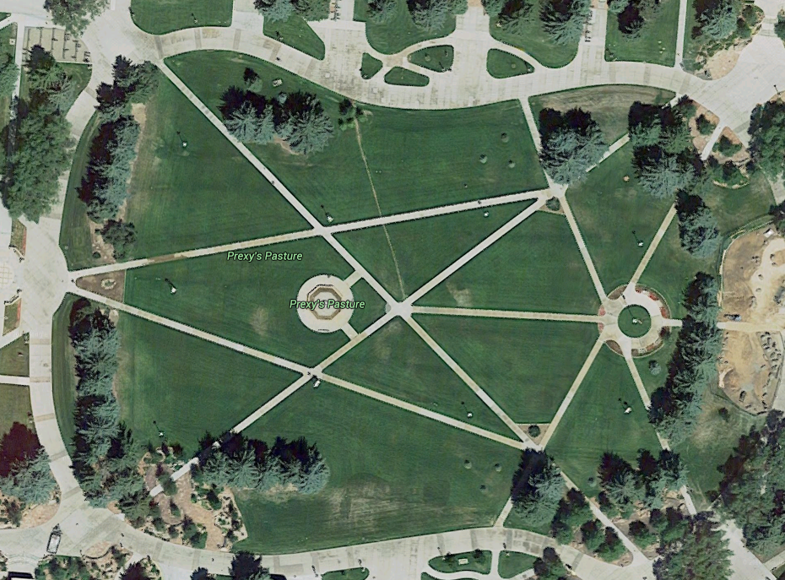
The Problem
Google Maps provides users with satellite images. That is great, but the images are update infrequently and low resolution

Slide 4
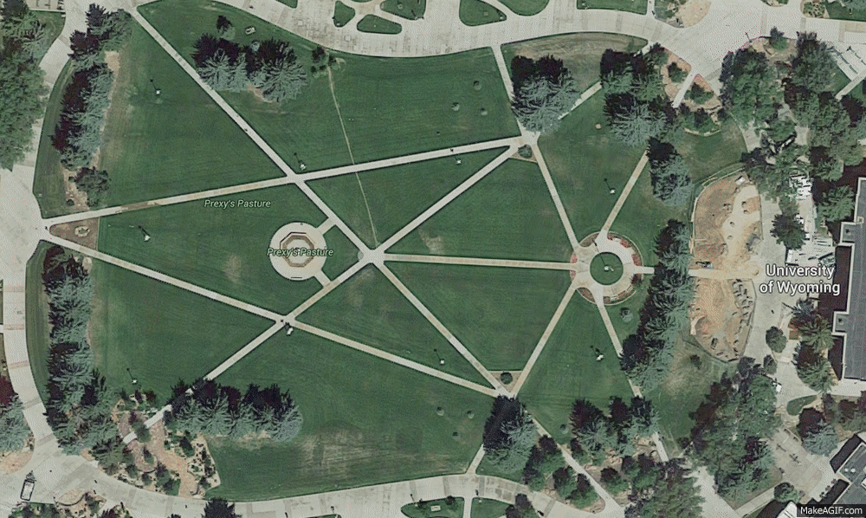
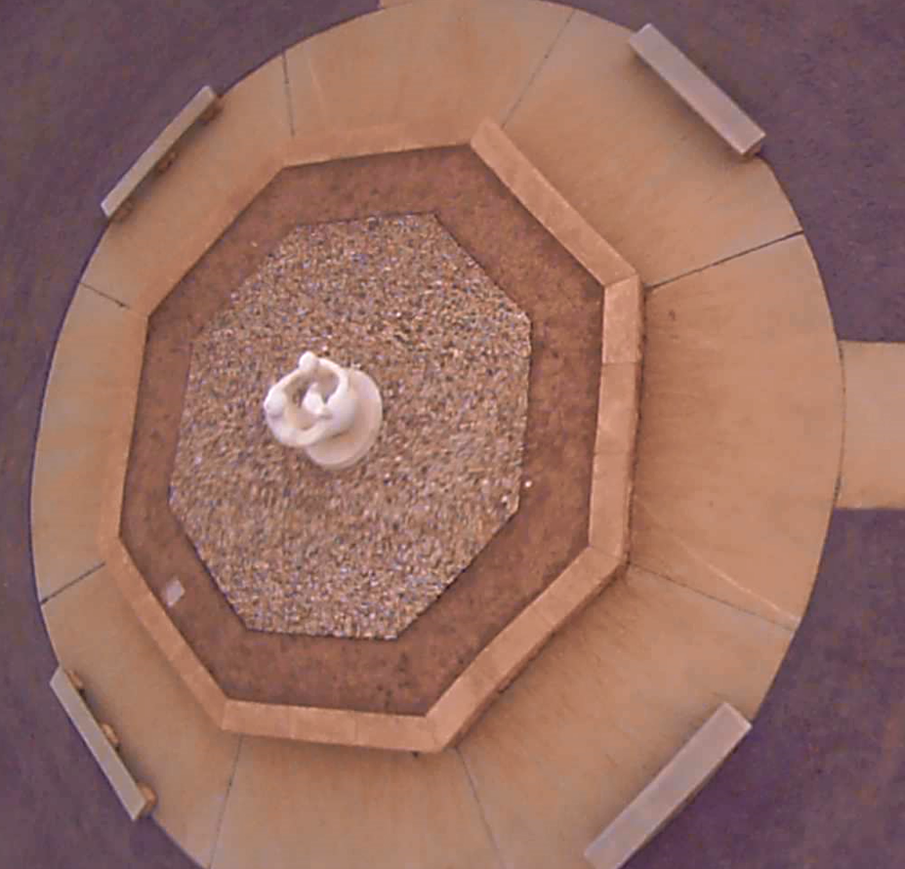
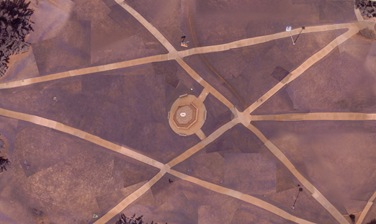
The Solution
Automated Cartography Solutions.
Notes:
500 img, 15mn

Slide 5
Potential Uses
Who needs more update maps?
Open face mines
Construction companies
Farmers
Disaster Reconnaissance

Slide 6
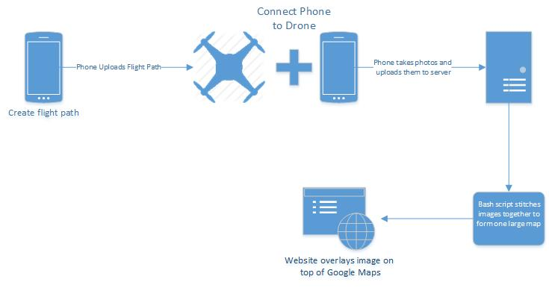
Project Overview

Slide 7
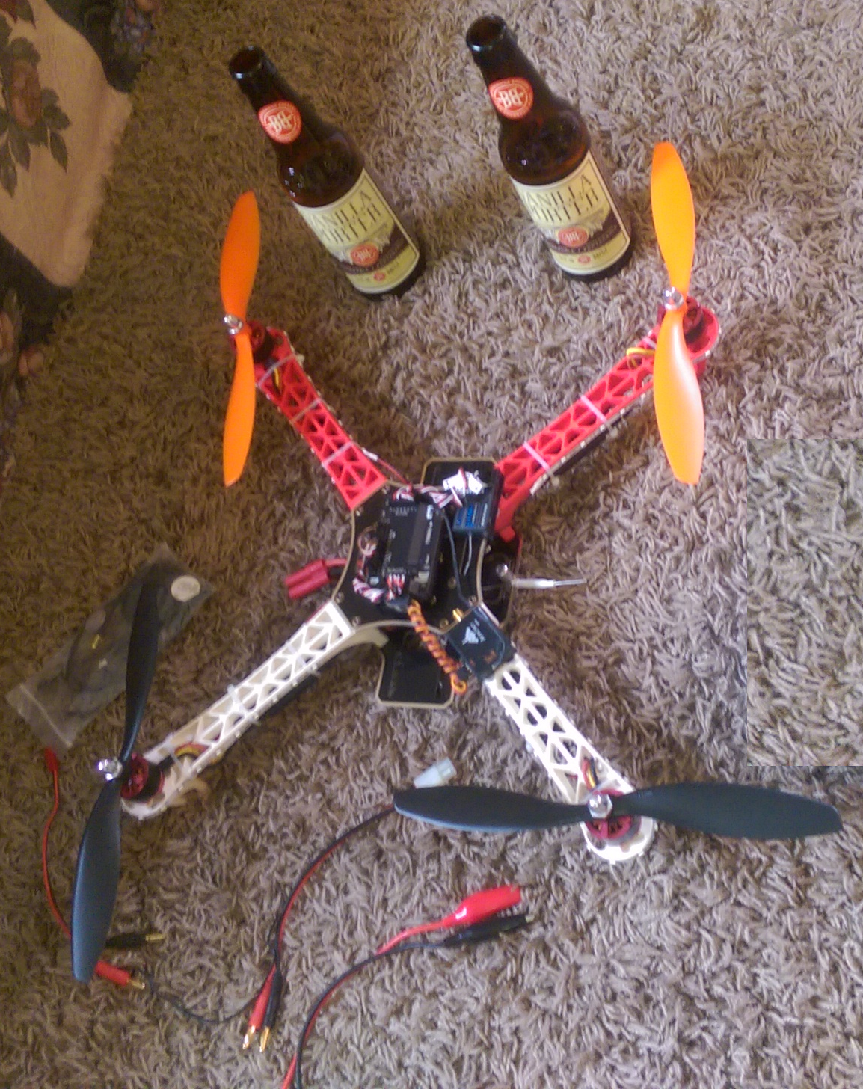
What we needed
Open source
Programmable
Payload of ~1lb
GPS functionality

Slide 8
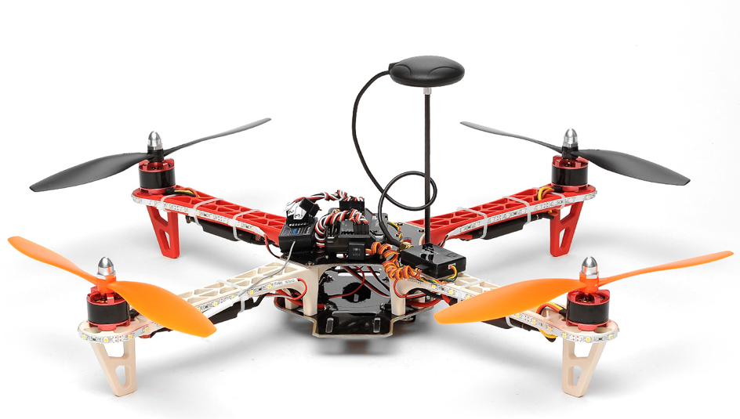
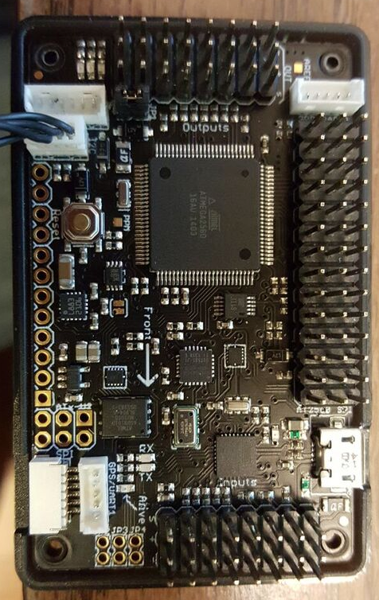
AeroSky P12 Quadcopter
Lipo-Battery
2200 mAh ~ 20 minutes flight time
APM 2.5 Arduino board
Open source and programmable
U-blox NEO-6M GPS module
Accuracy 3 – 5ft
2lb Payload
Notes:
Accuracy:
Position 2.5 m CEP
SBAS 2.0 m CEP
8

Slide 9
Transition between app and drone?
High level app, why do what we did?

Slide 10
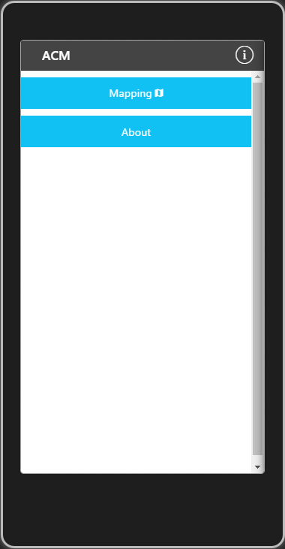
ACS App – Home

Slide 11
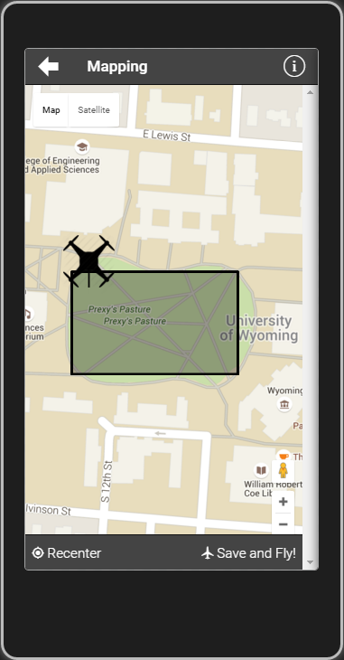
ACS App – Settings

Slide 12
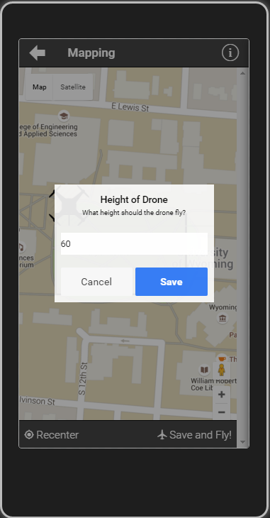
ACS App – Map

Slide 13
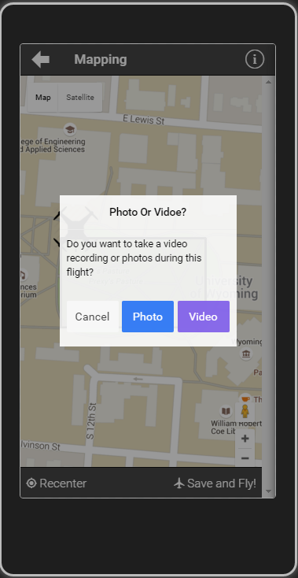
ACS App – Map

Slide 14
ACS App – Settings

Slide 15
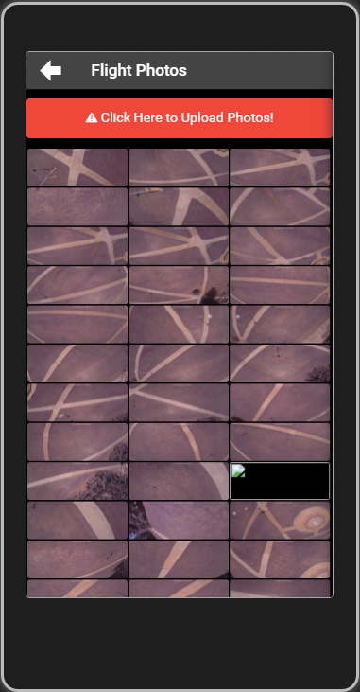
ACS App – Pictures

Slide 16
The Result
Notes:
500 img, 15mn

Slide 17
App Overview
Cross Platform app utilizing:
AngularJS (1.4)
Apache Cordova (3.5.1)
Ionic(1.2.4)
jQuery
Creates flight path
Takes photo/videos
Upload photos/videos to the server

Slide 18
Server Infrastructure Overview

Slide 19
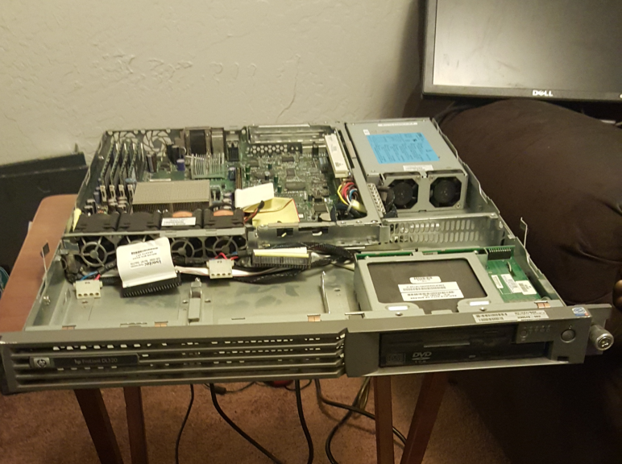
Primary Database Server
Running Windows Server 2012
Uses MySQL
Meta Data
Image Locations
Originally several bash scripts
to process the images on a
Xubuntu server
HP ProLiant DL320

Slide 20
Server Side Code
Formats images to a uniform size
Scrapes image metadata
Enforces image naming conventions
Creates a master image list
Passes images to Autodesk 123D Catch

Slide 21

Autodesk 123D Catch
Creates 3D objects using a large set of images
Originally we created a system using ImageMagick and Javascript
Now we record video with the phone and scrape images from it using VLC Player

Slide 22
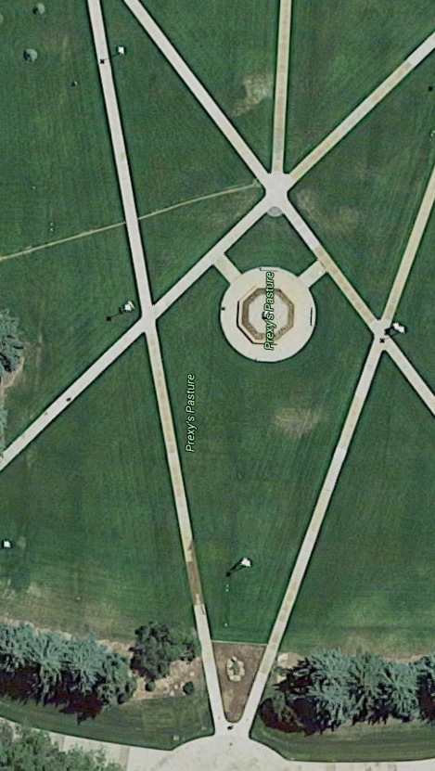
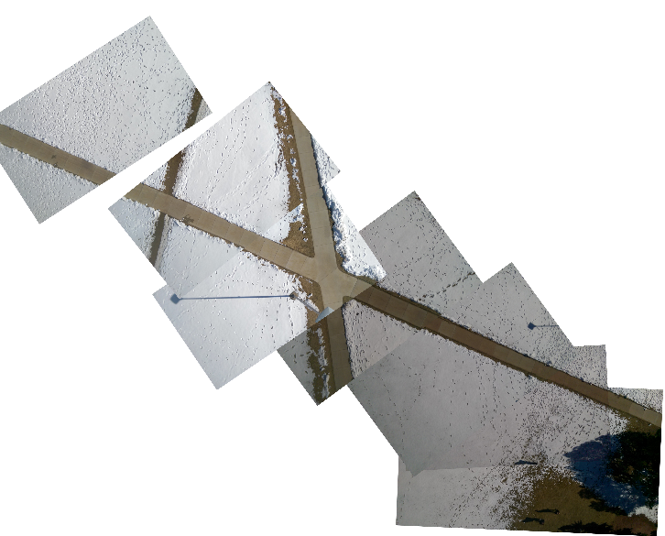
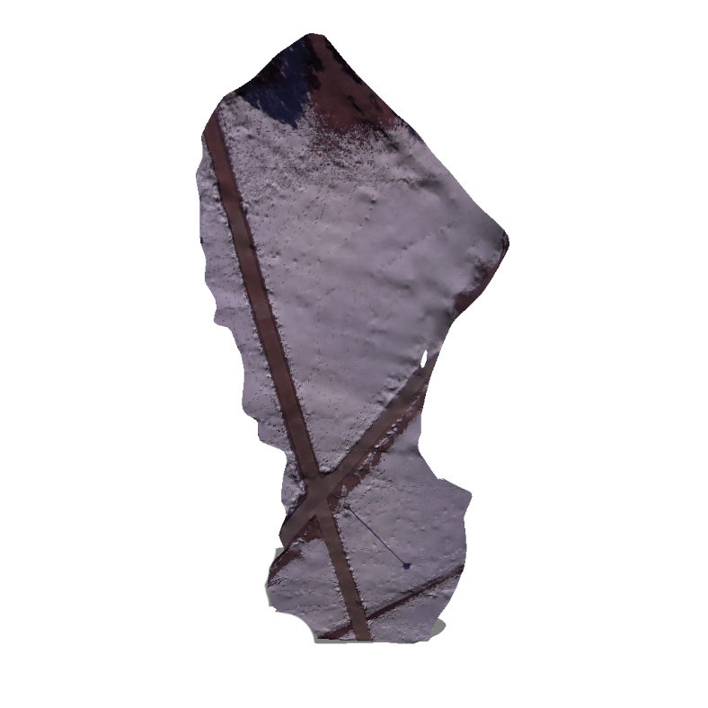
Original map
Autodesk Render

Slide 23
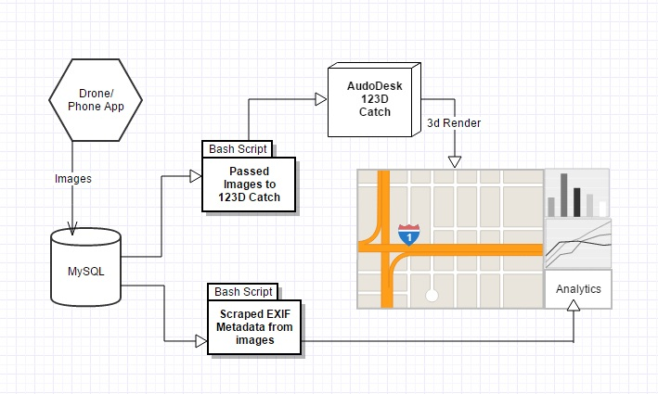
Overview

Slide 24
Analytical Information
Average speed
Estimated distance between images
GPS information
EXIF data from picture
Notes:
Could be compiled into an automated report that can be emailed to the user after each flight.
24

Slide 25
Reporting Tools
Add Website
Maybe just a ton of logs from Mission Planner

Slide 26
What can we do with the logs business info/ point of view?

Slide 27
Future Improvements
Low cost hardware upgrades
Sonar
Hexa-Copter
Move software to Cloud
Automatically generated reports
Camera stabilizing mount
Real time video rendering

Slide 28
Q
A
&
Notes:
28

